Slide 1
Restaurant categories in Switzerland
Pierre-Olivier Guimond, 23.02.2020

Slide 2
Introduction
People in Switzerland have their own cultures, cuisines, and traditions, which have also inherited some influence from the neighbouring cultures
-> How do the type, amount and diversity of restaurants depend on the location throughout the canton of Vaud?
Question of great interest for individuals wishing to open a restaurant, or for restaurant chain owners looking to open new units

Slide 3
Communes as territorial divisions: properties

Slide 4
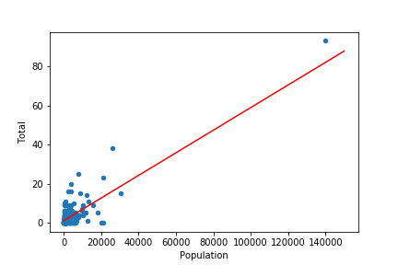
Communes as territorial divisions: properties (cont’d)

Slide 5
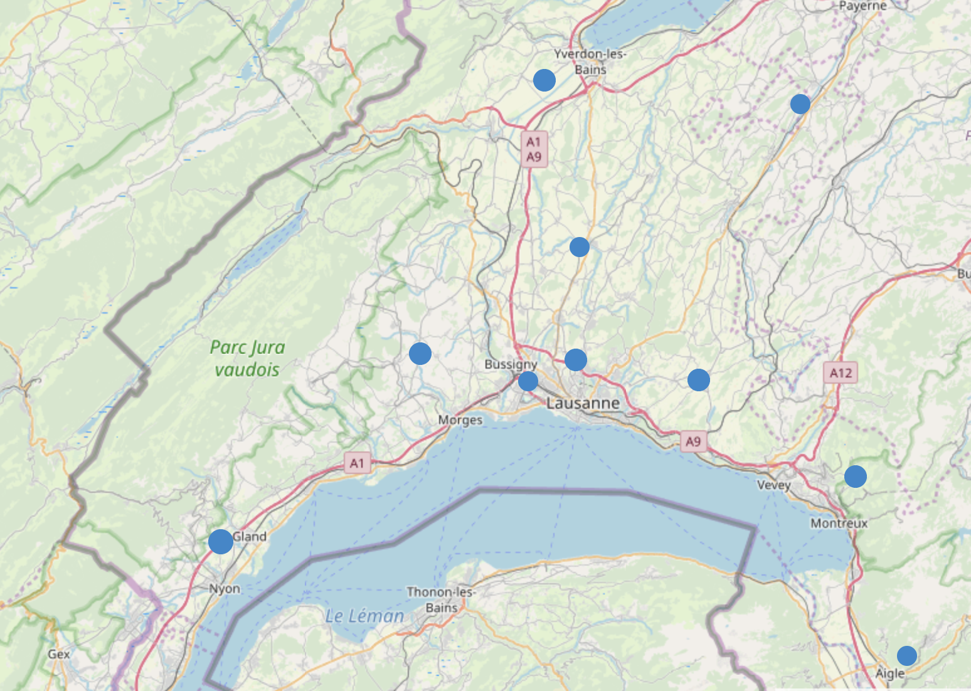
Districts as larger territorial divisions: properties of restaurants categories

Slide 6
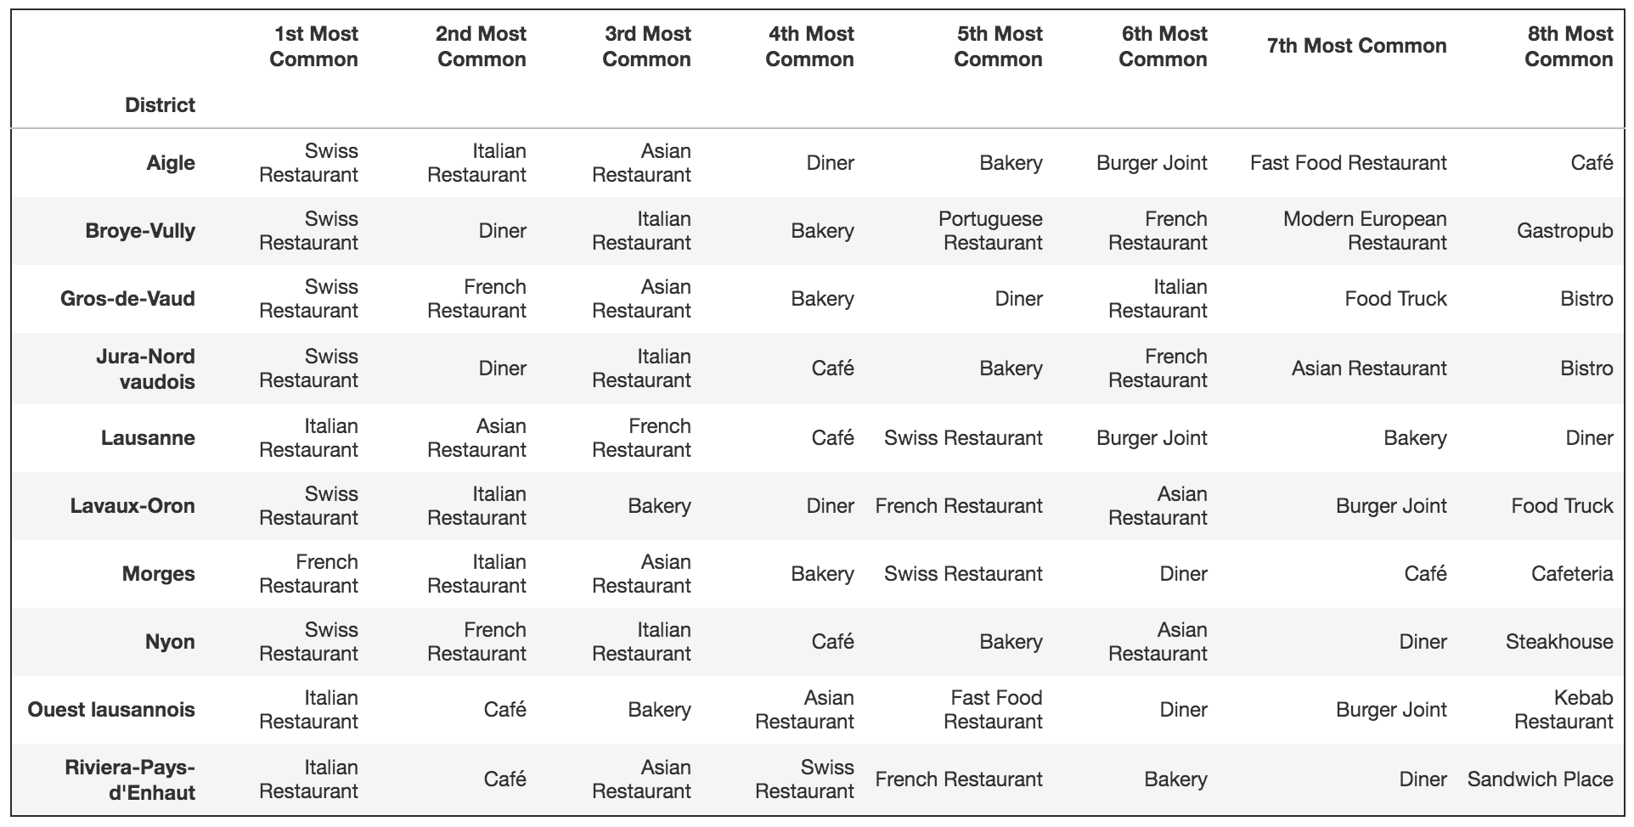
Districts as larger territorial divisions: properties of restaurants categories (cont’d)

Slide 7
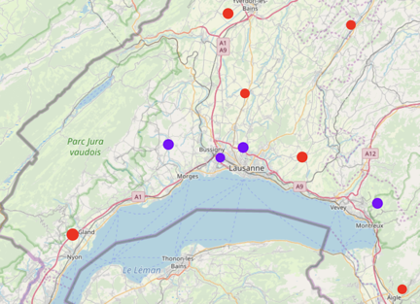
Clustering districts: 2 clusters

Slide 8
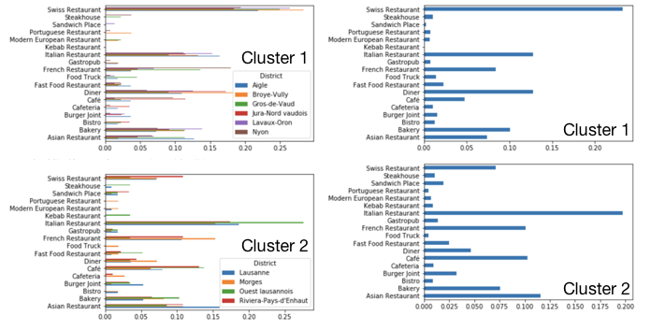
Clustering districts: 2 clusters (cont’d)

Slide 9
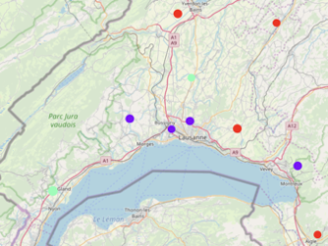
Clustering districts: 3 clusters

Slide 10
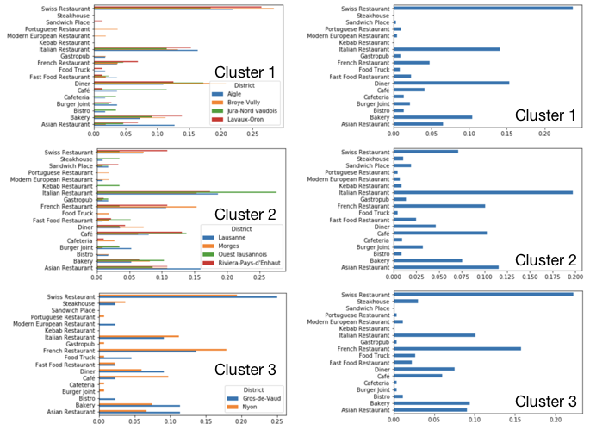
Clustering districts: 3 clusters (cont’d)

Slide 11
Clustering districts: hierarchy

Slide 12
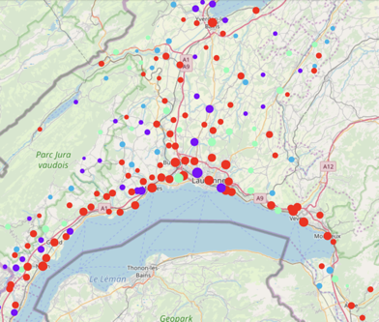
Clustering Communes: 4 clusters

Slide 13
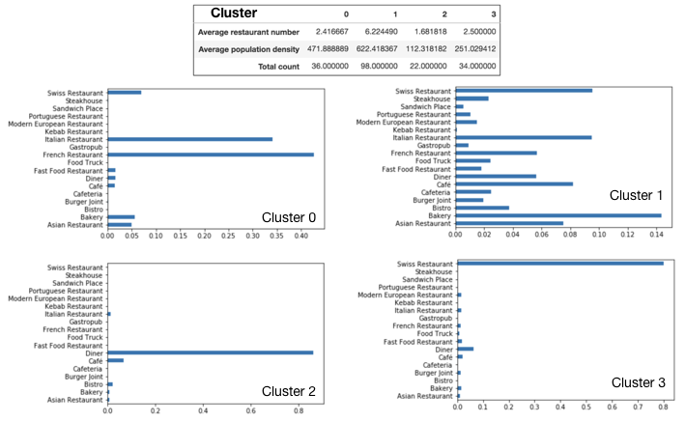
Clustering Communes: 4 clusters

Slide 14
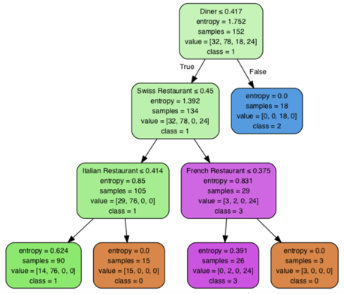
Clustering Communes: 4 clusters classification

Slide 15
Conclusions
Typical restaurants depend strongly on the population density and the geographical location.
Restaurants such as diners and Swiss restaurants are the typical types found in the countryside, i.e. in rural communes and districts with lower population density.
The more urban areas have a much broader distribution of restaurant categories, including a prevalence for Italian, French or Asian cuisine.

